Slide 1
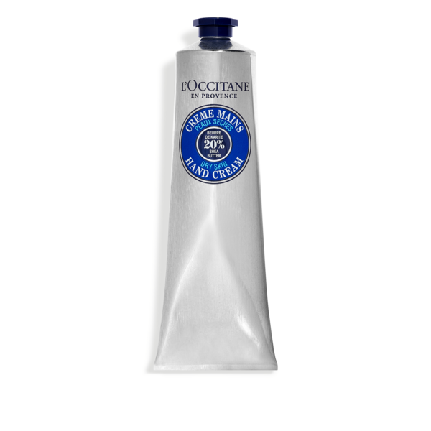
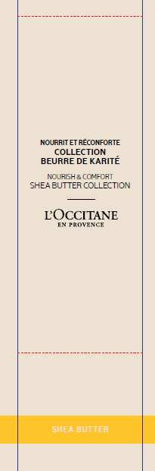
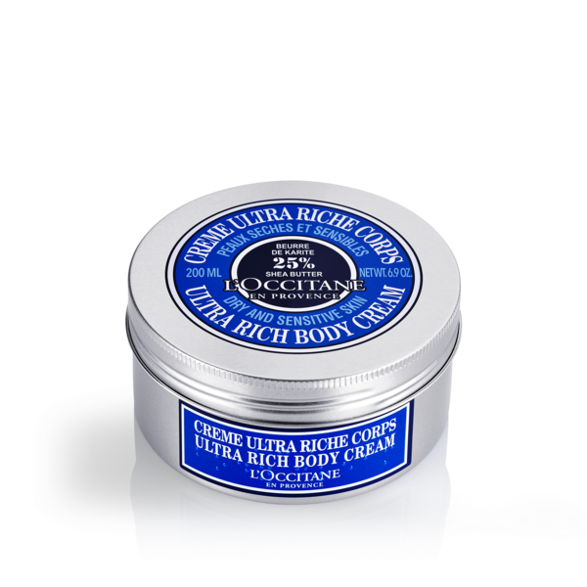
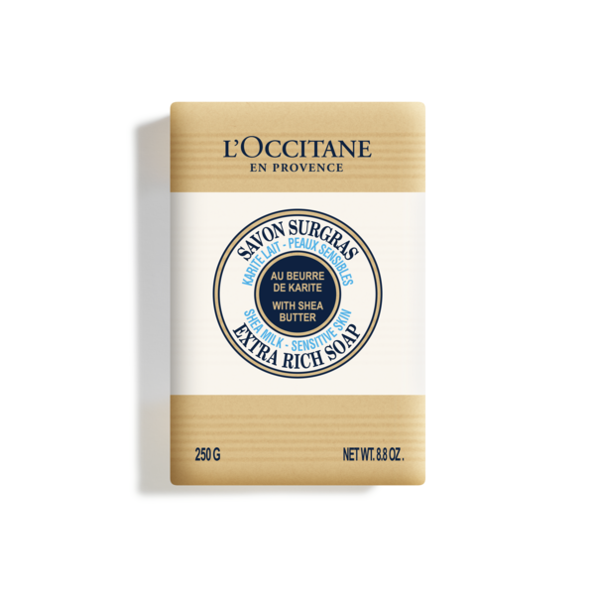
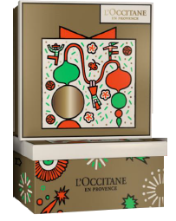
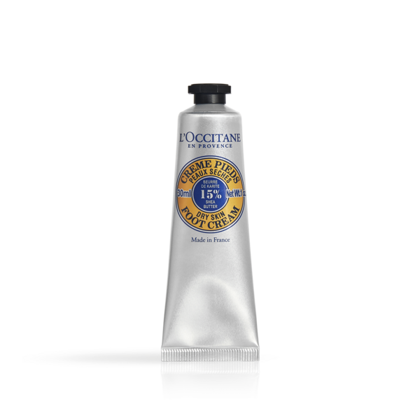
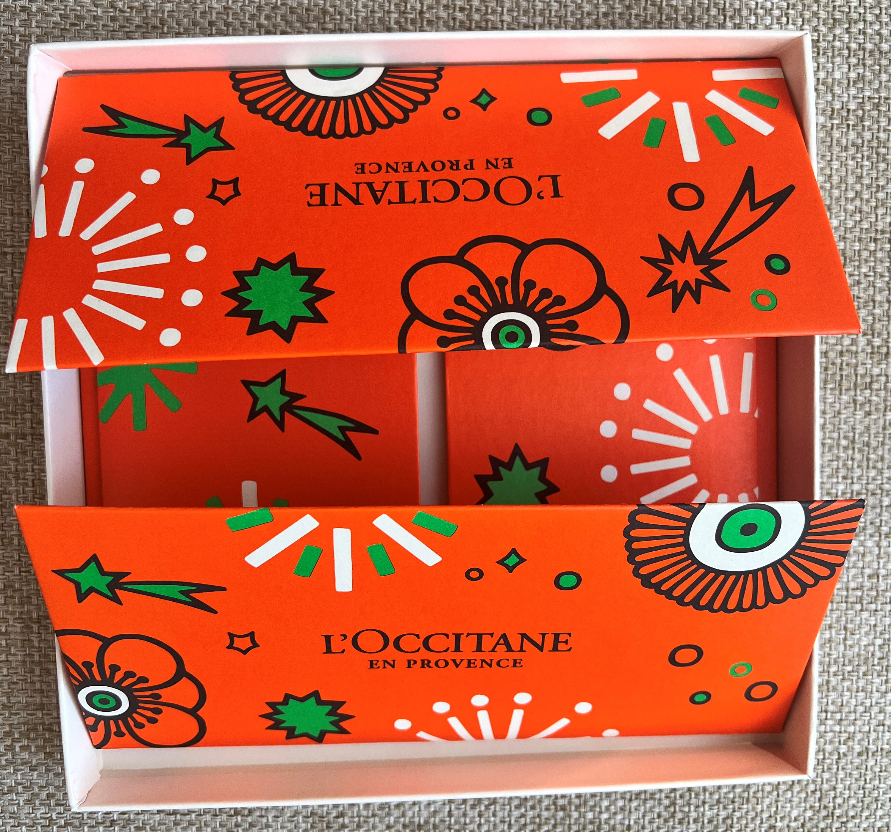
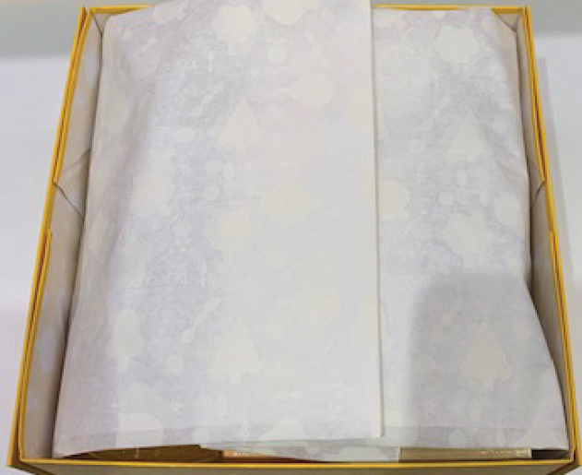
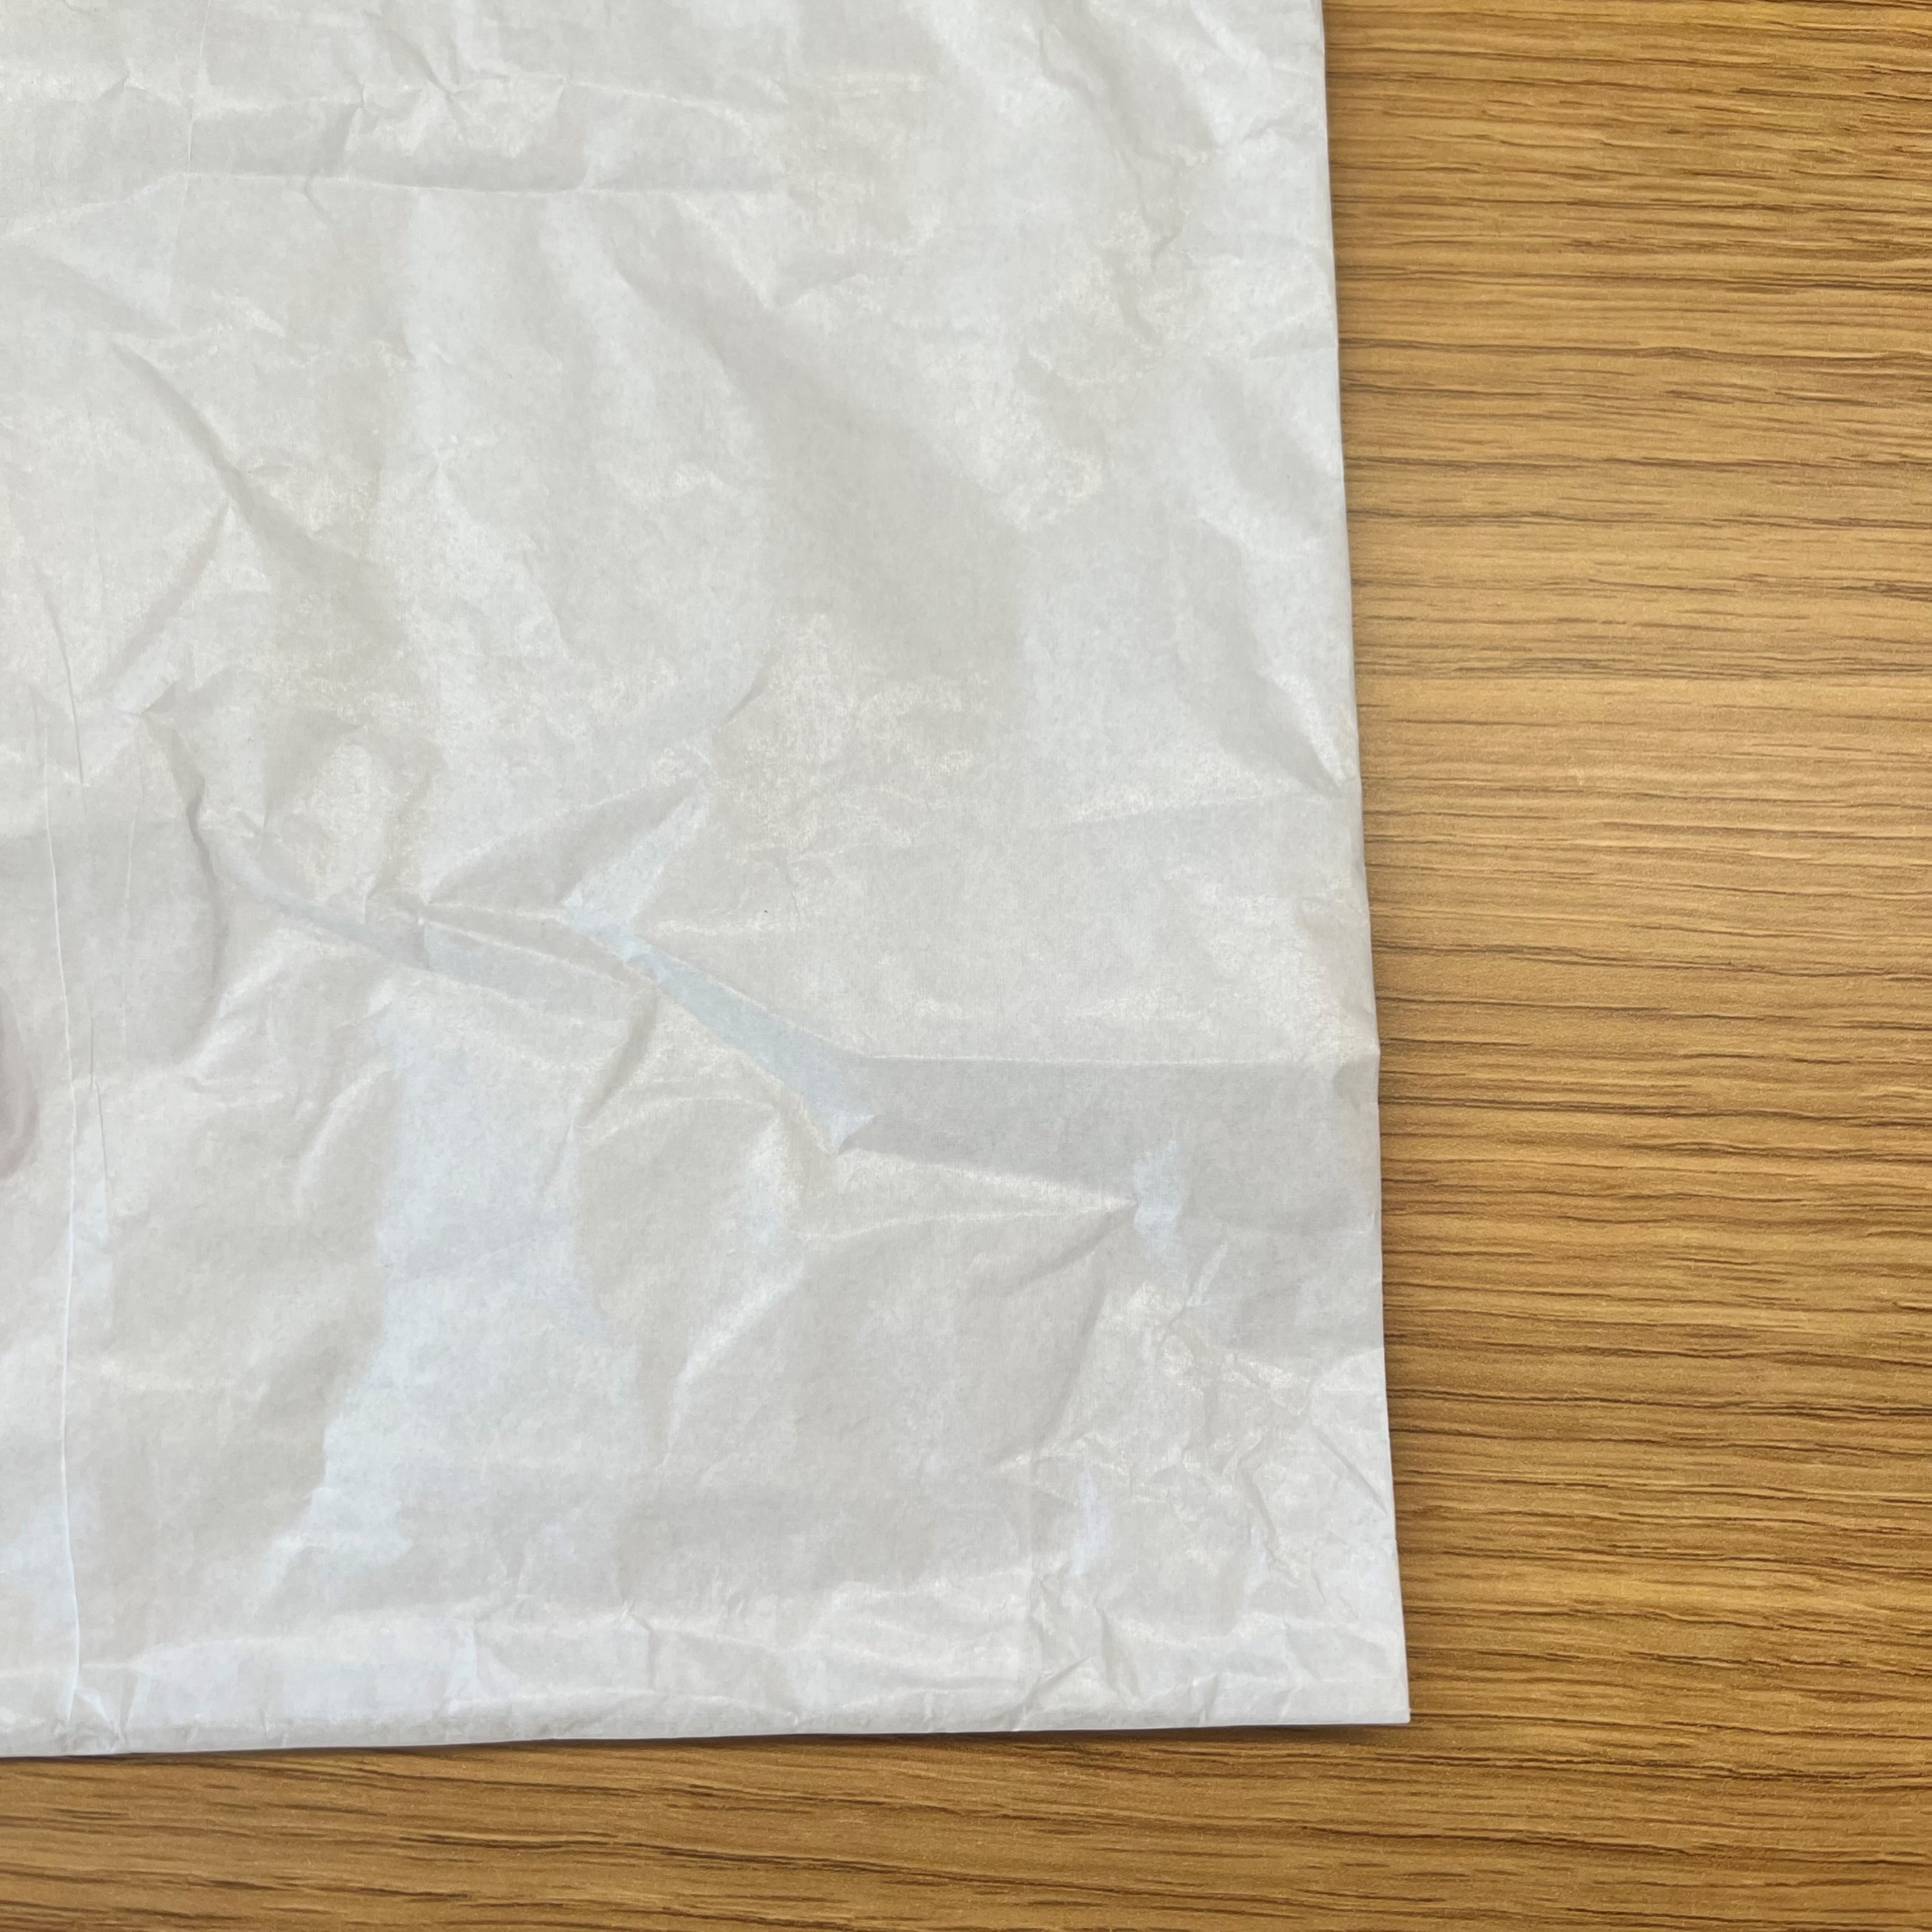

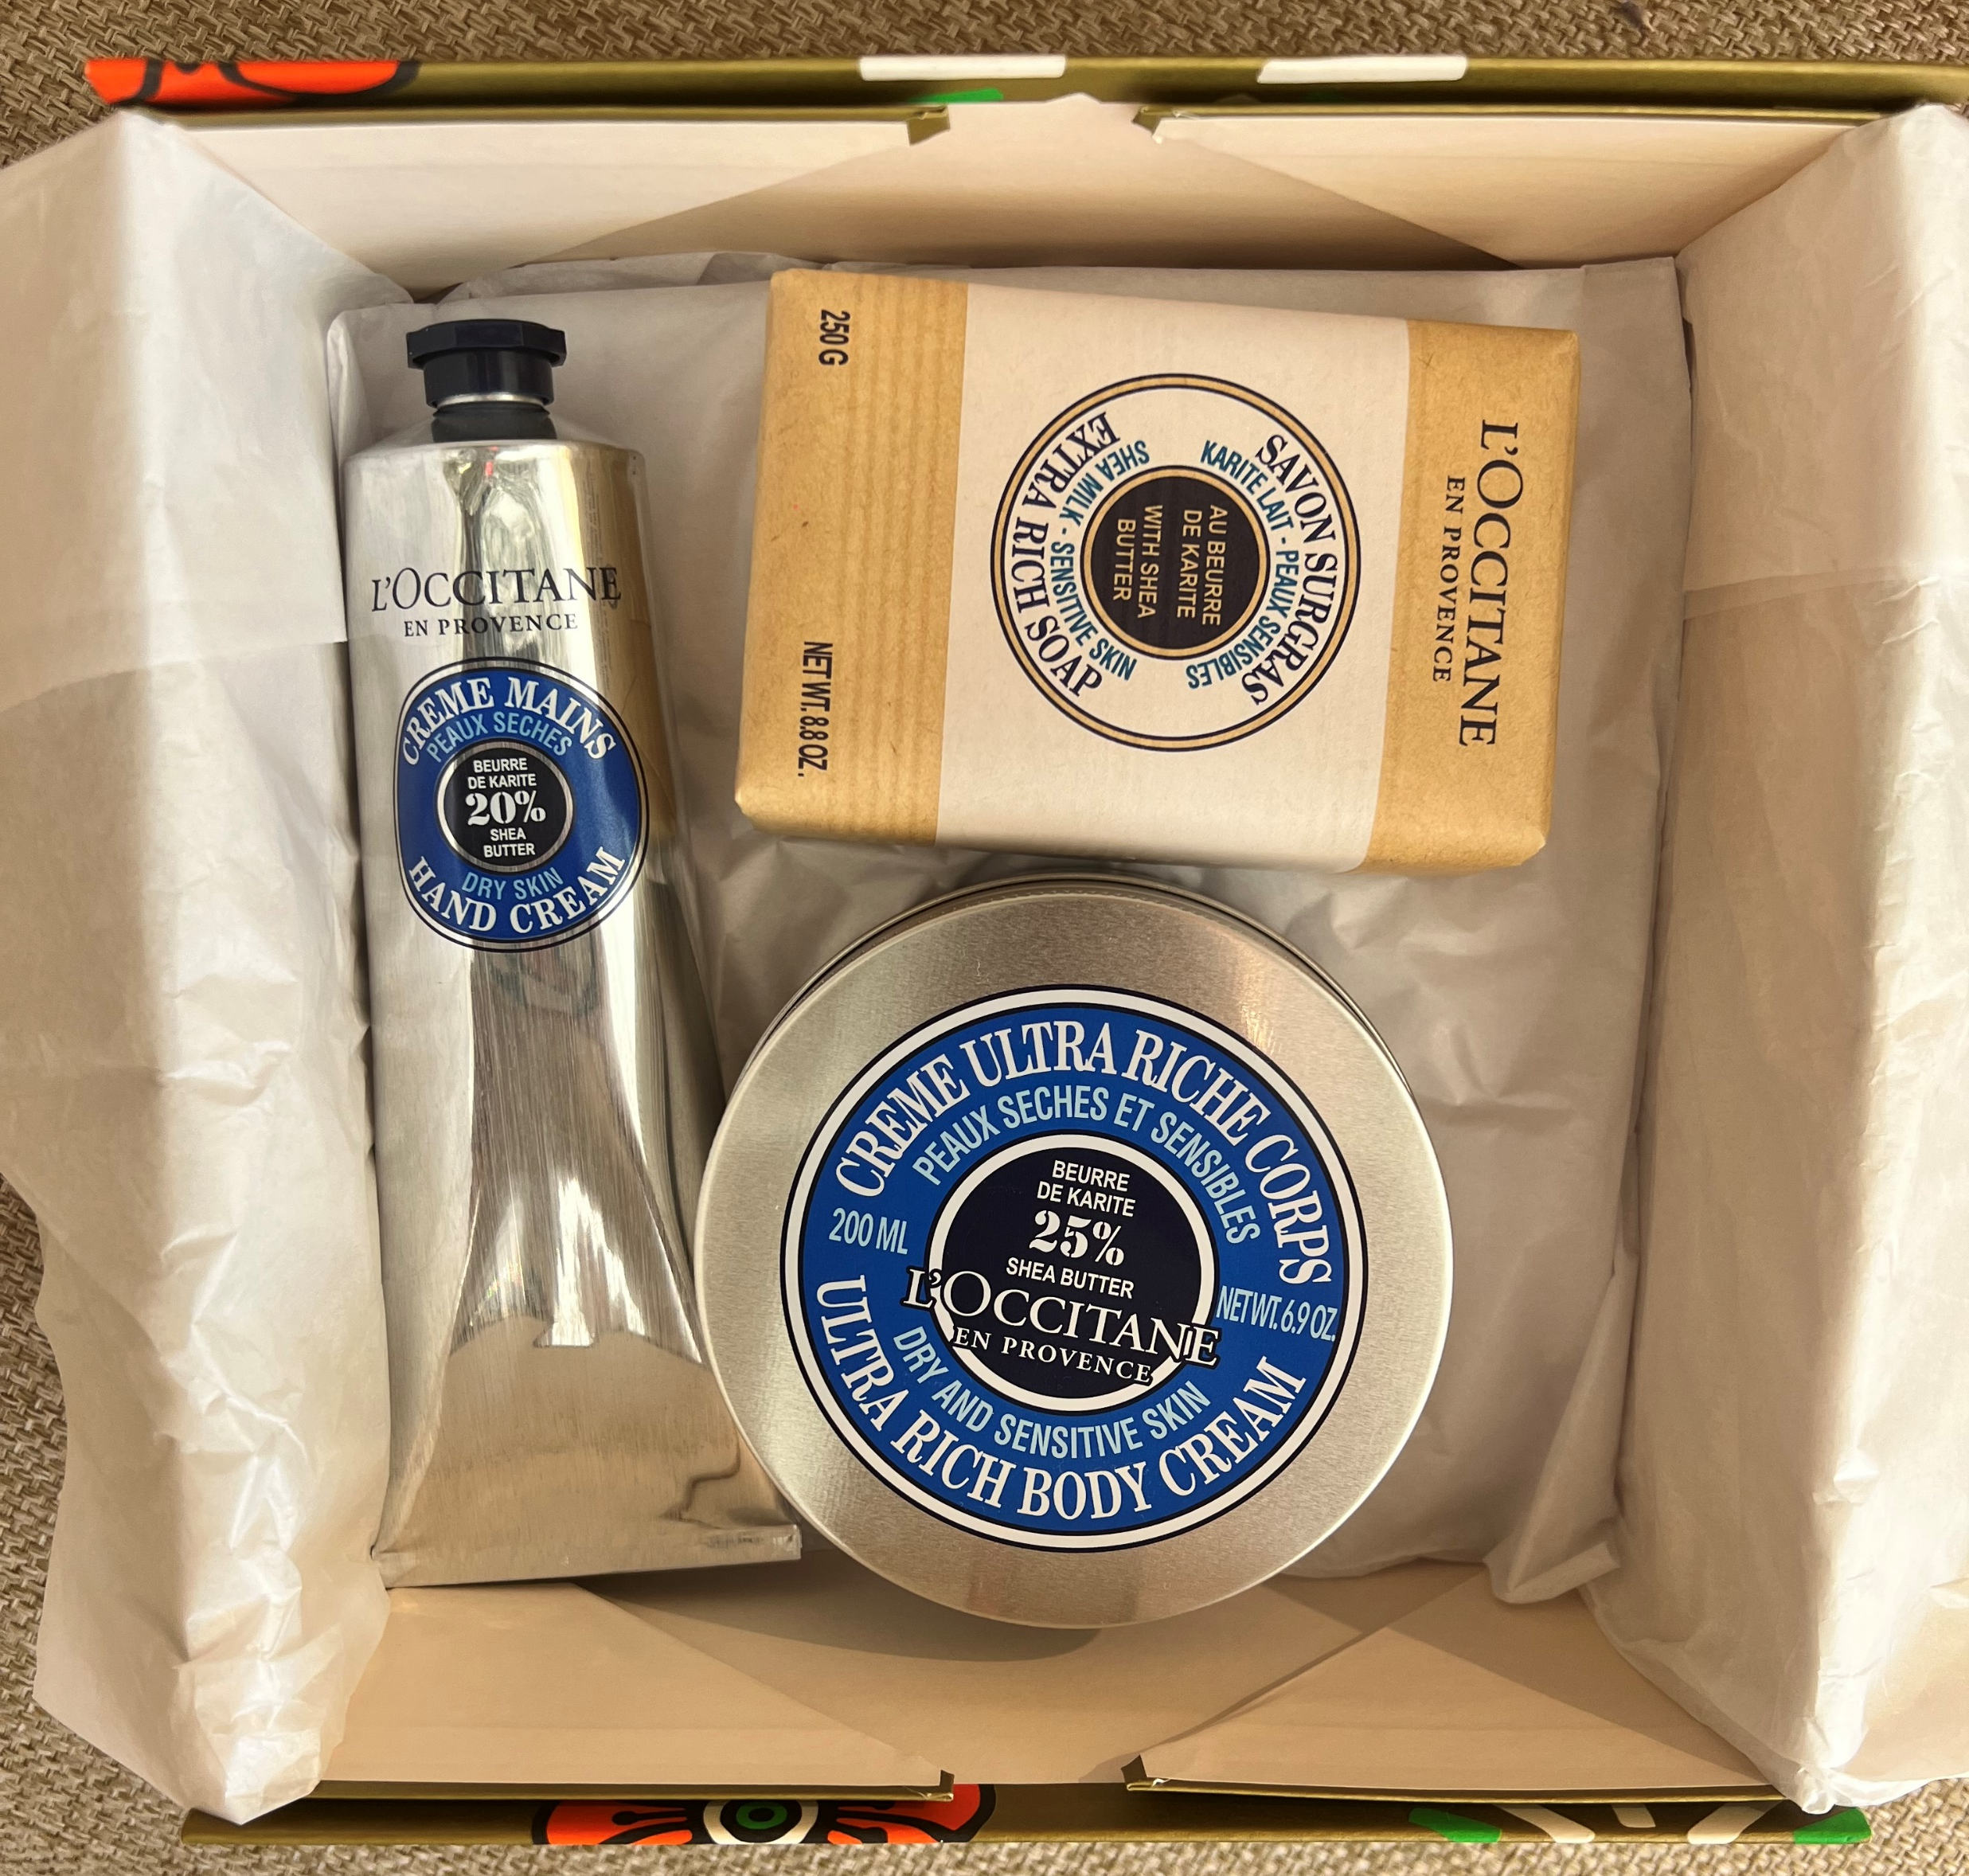
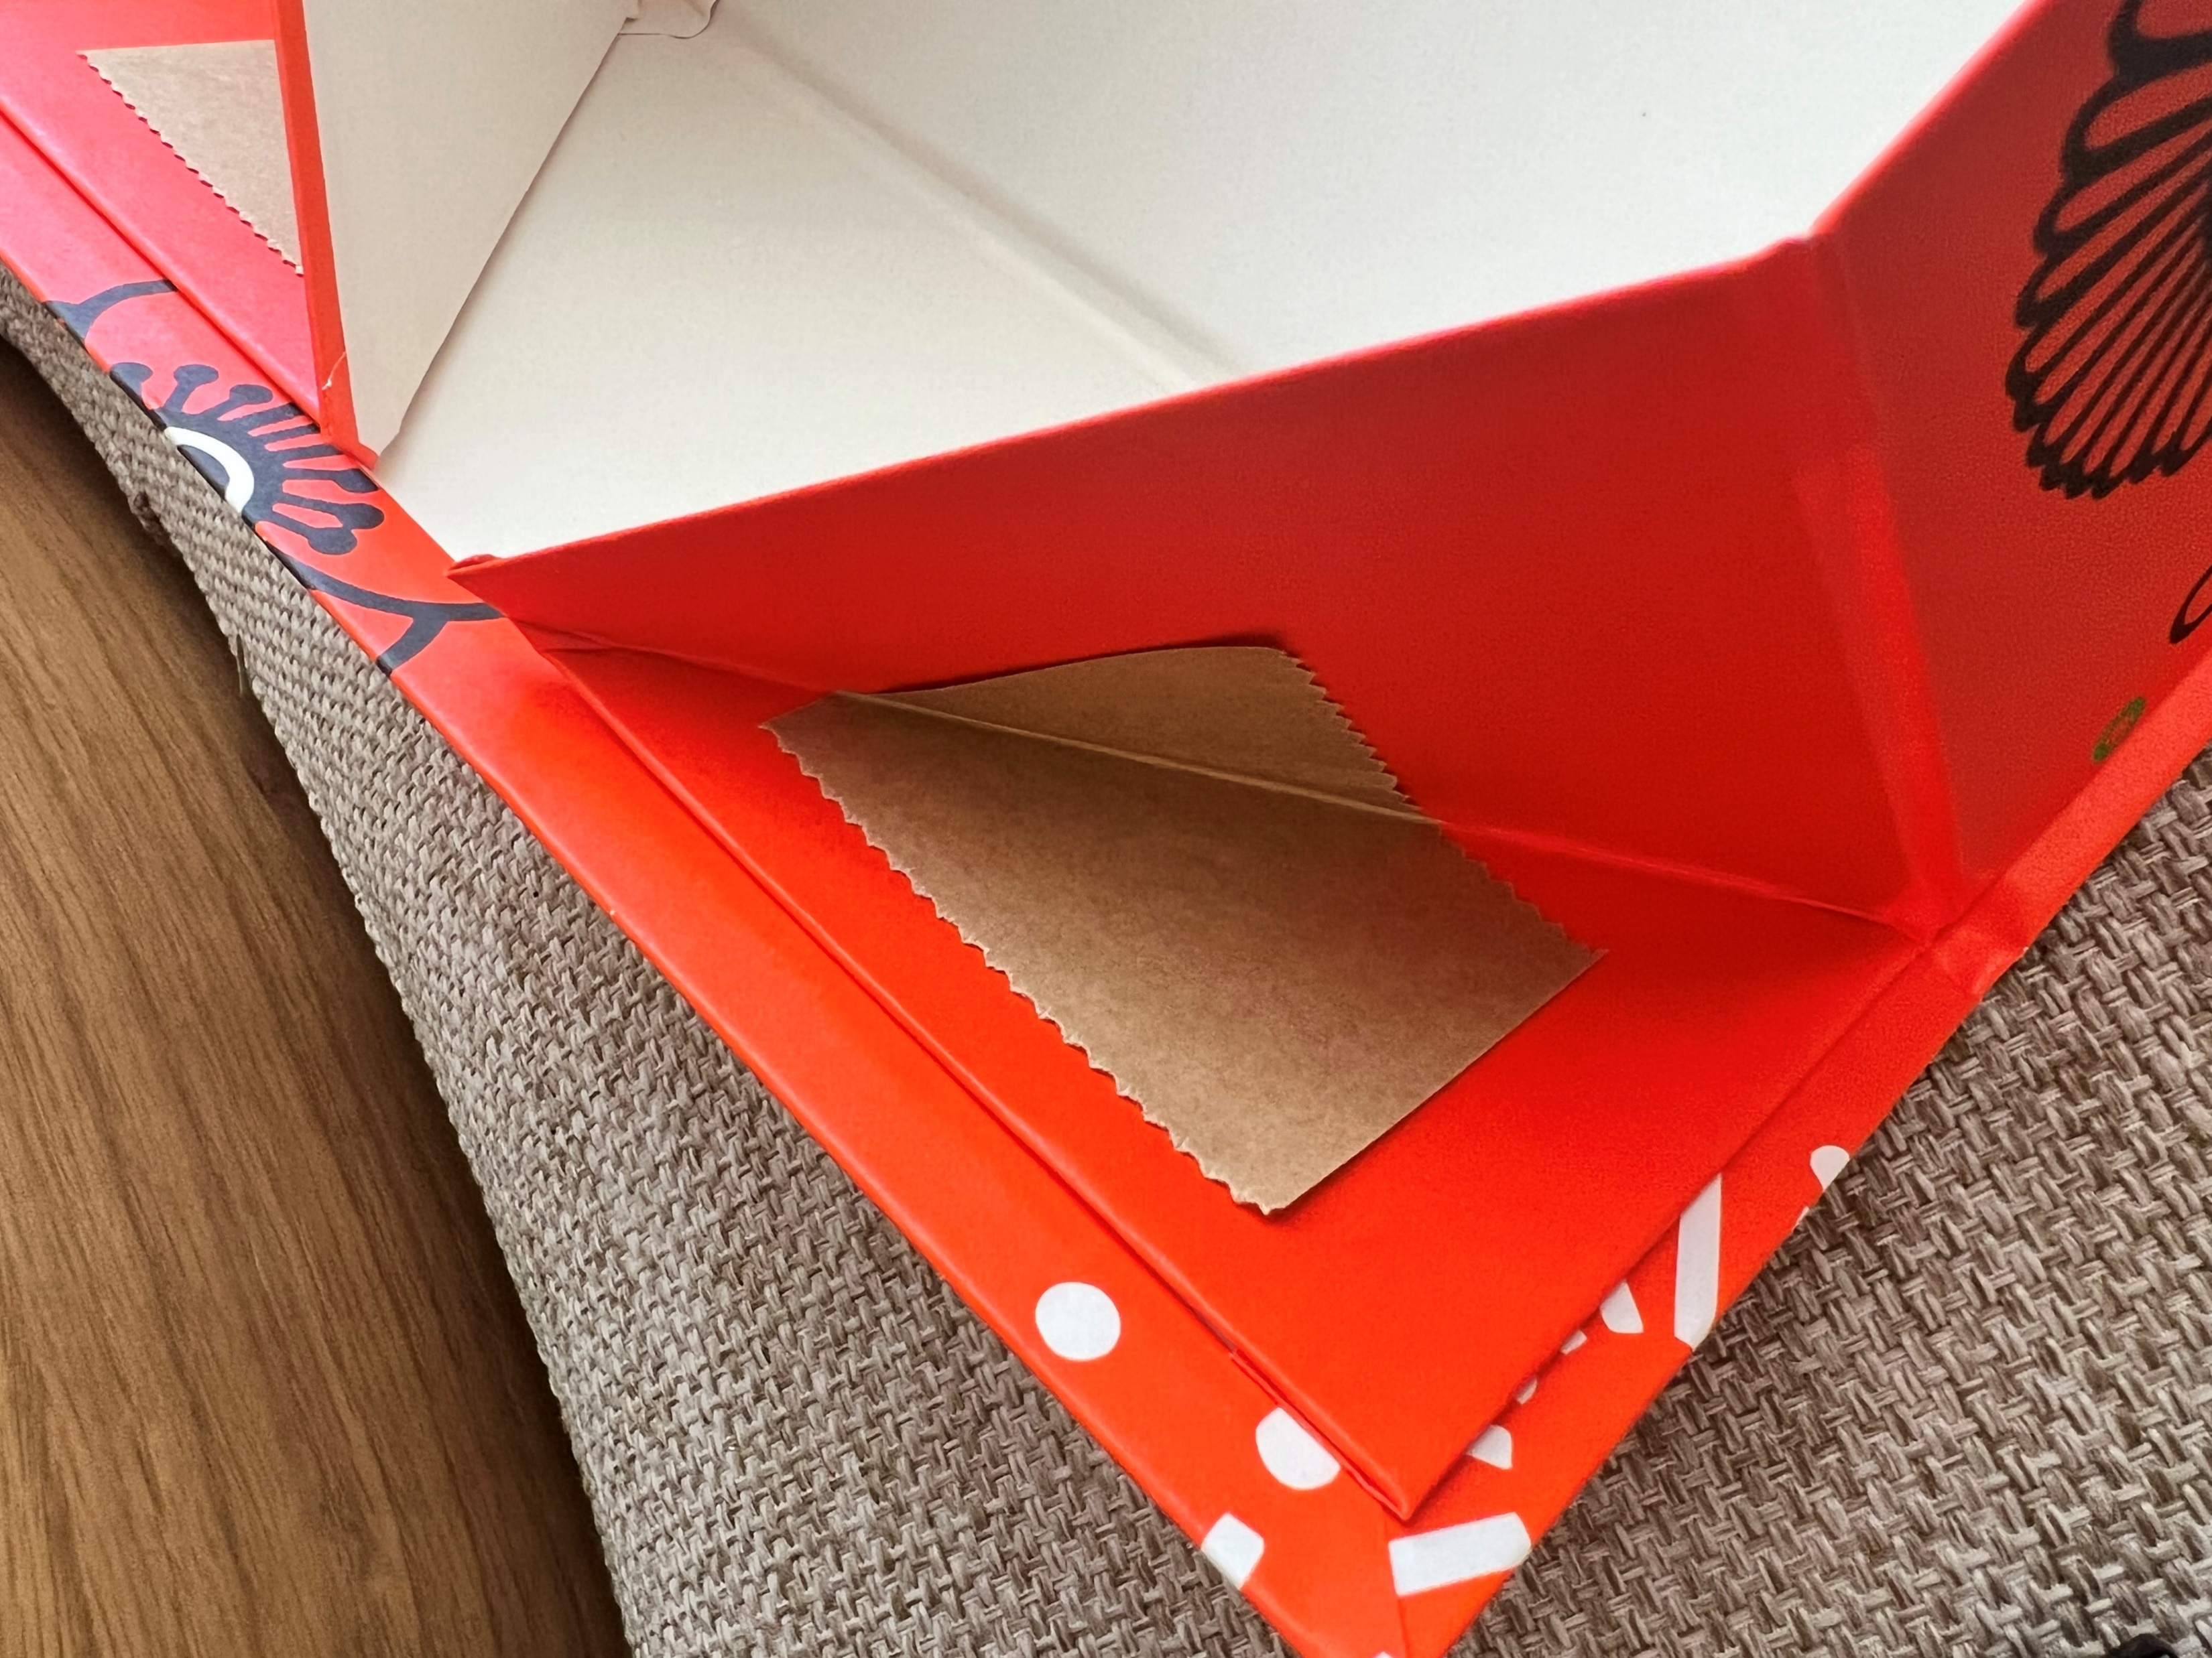
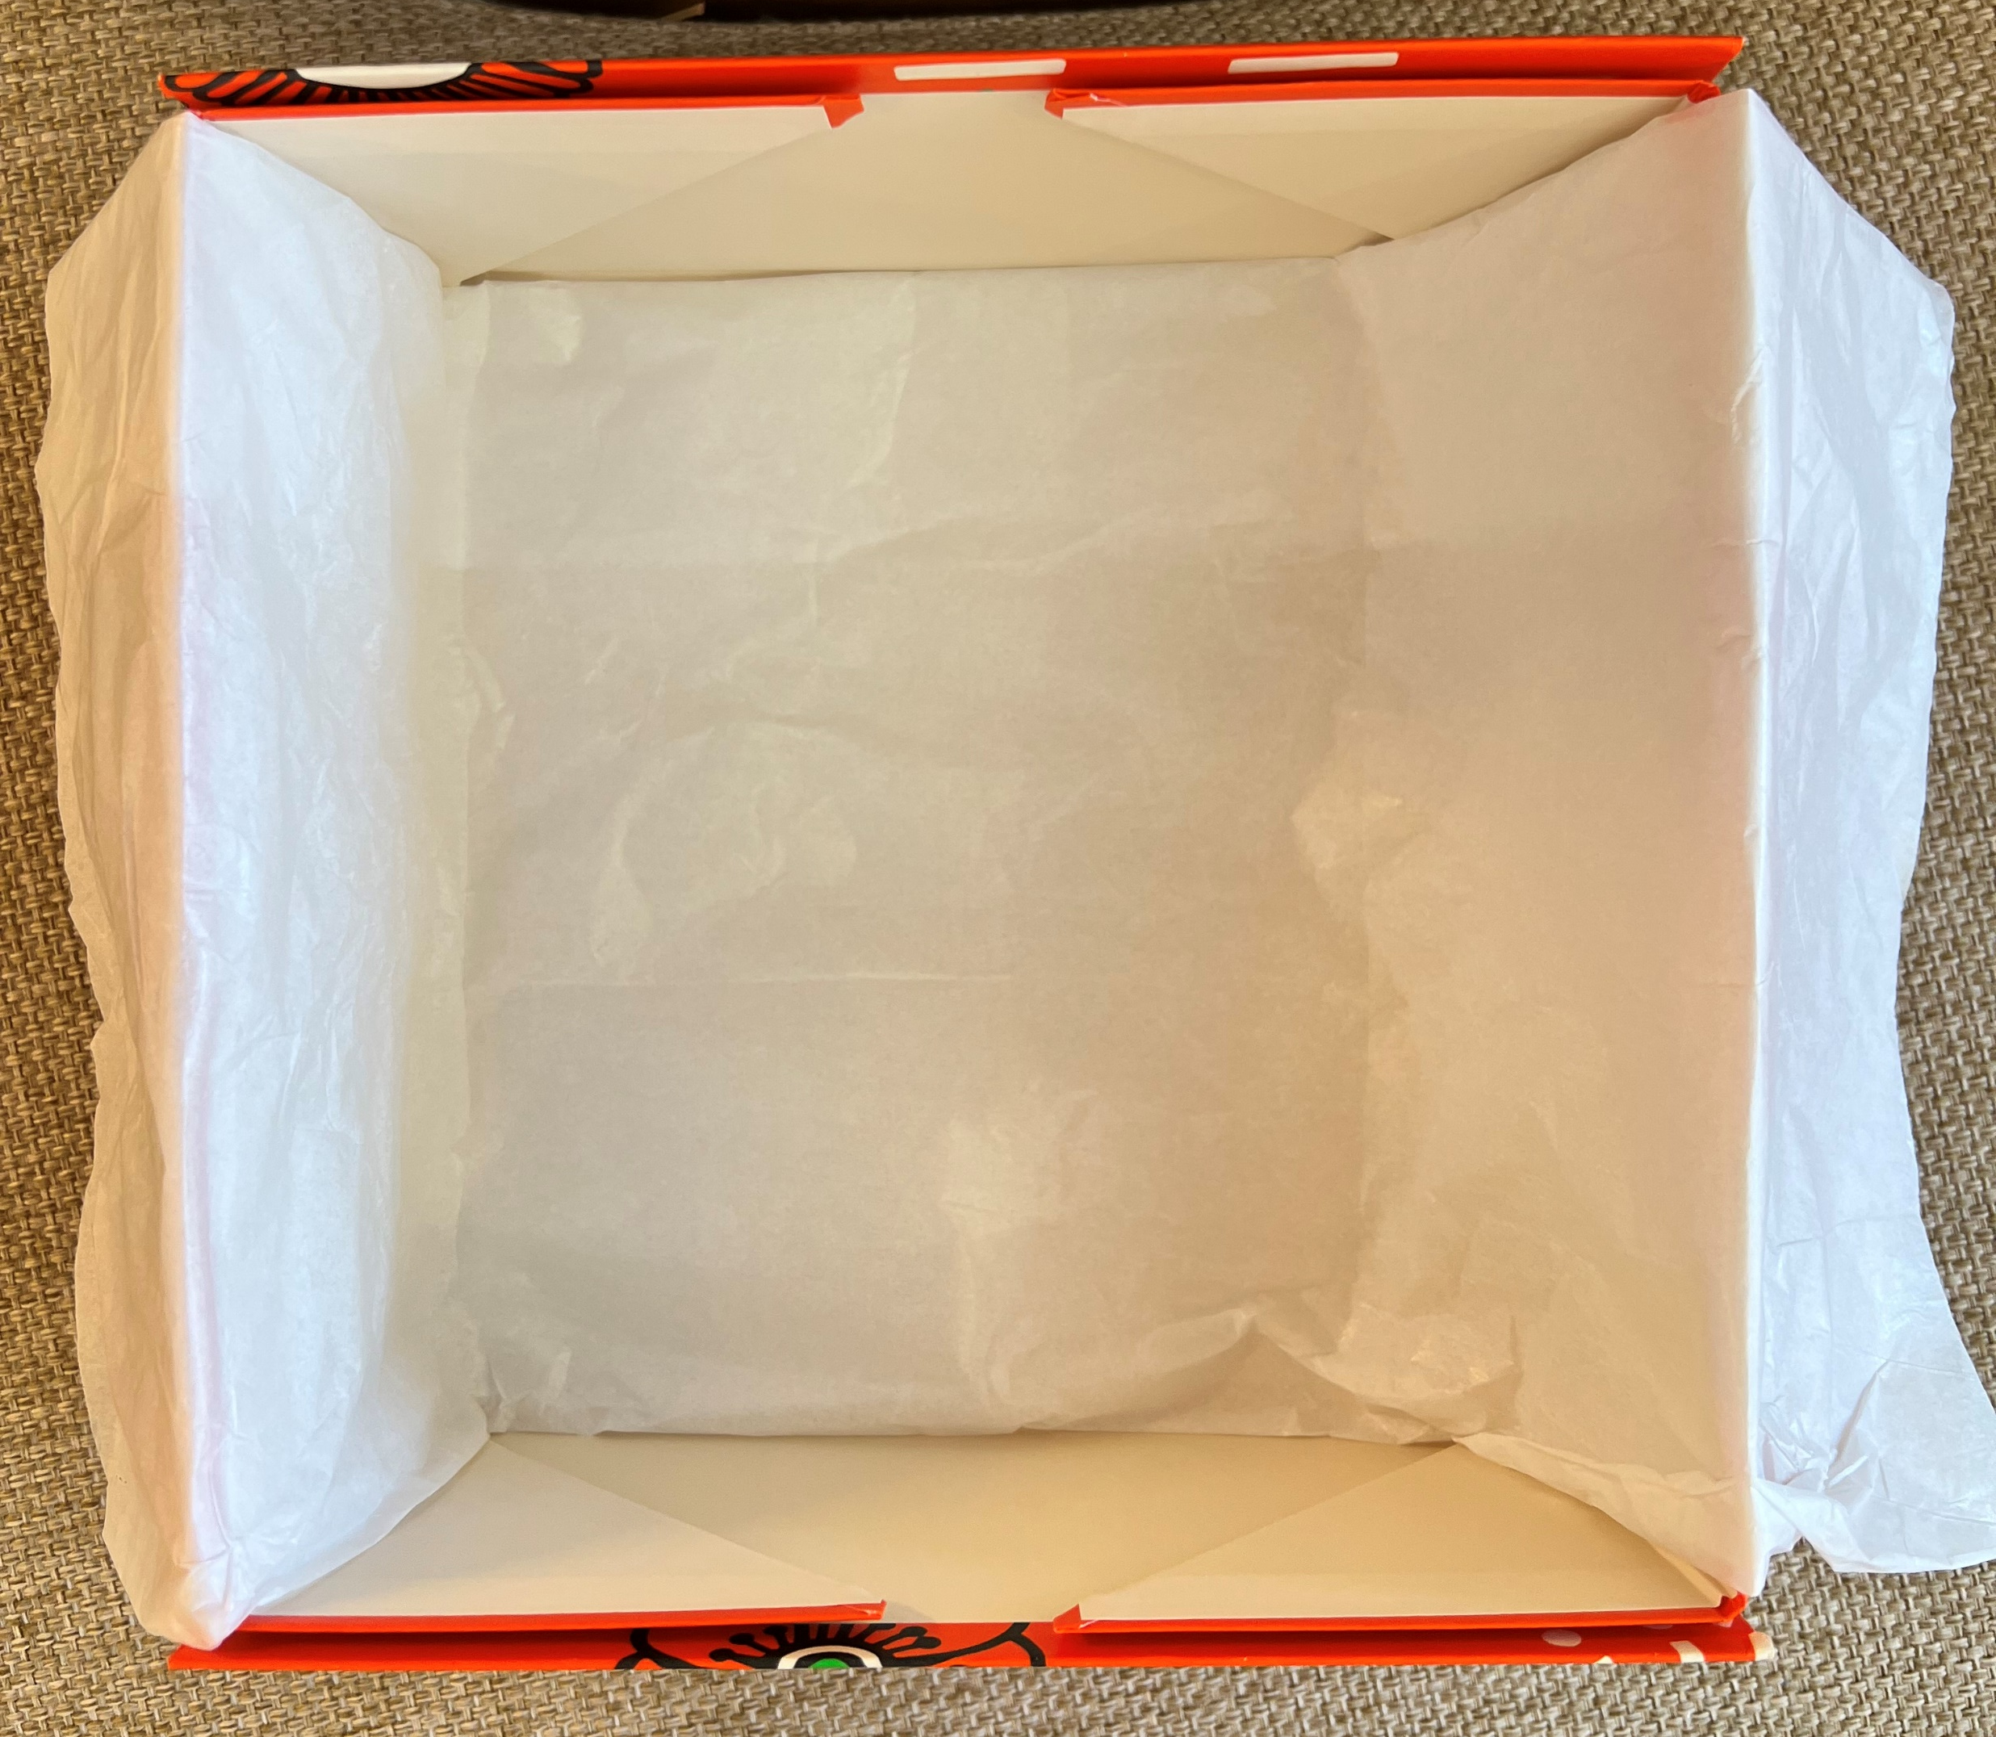
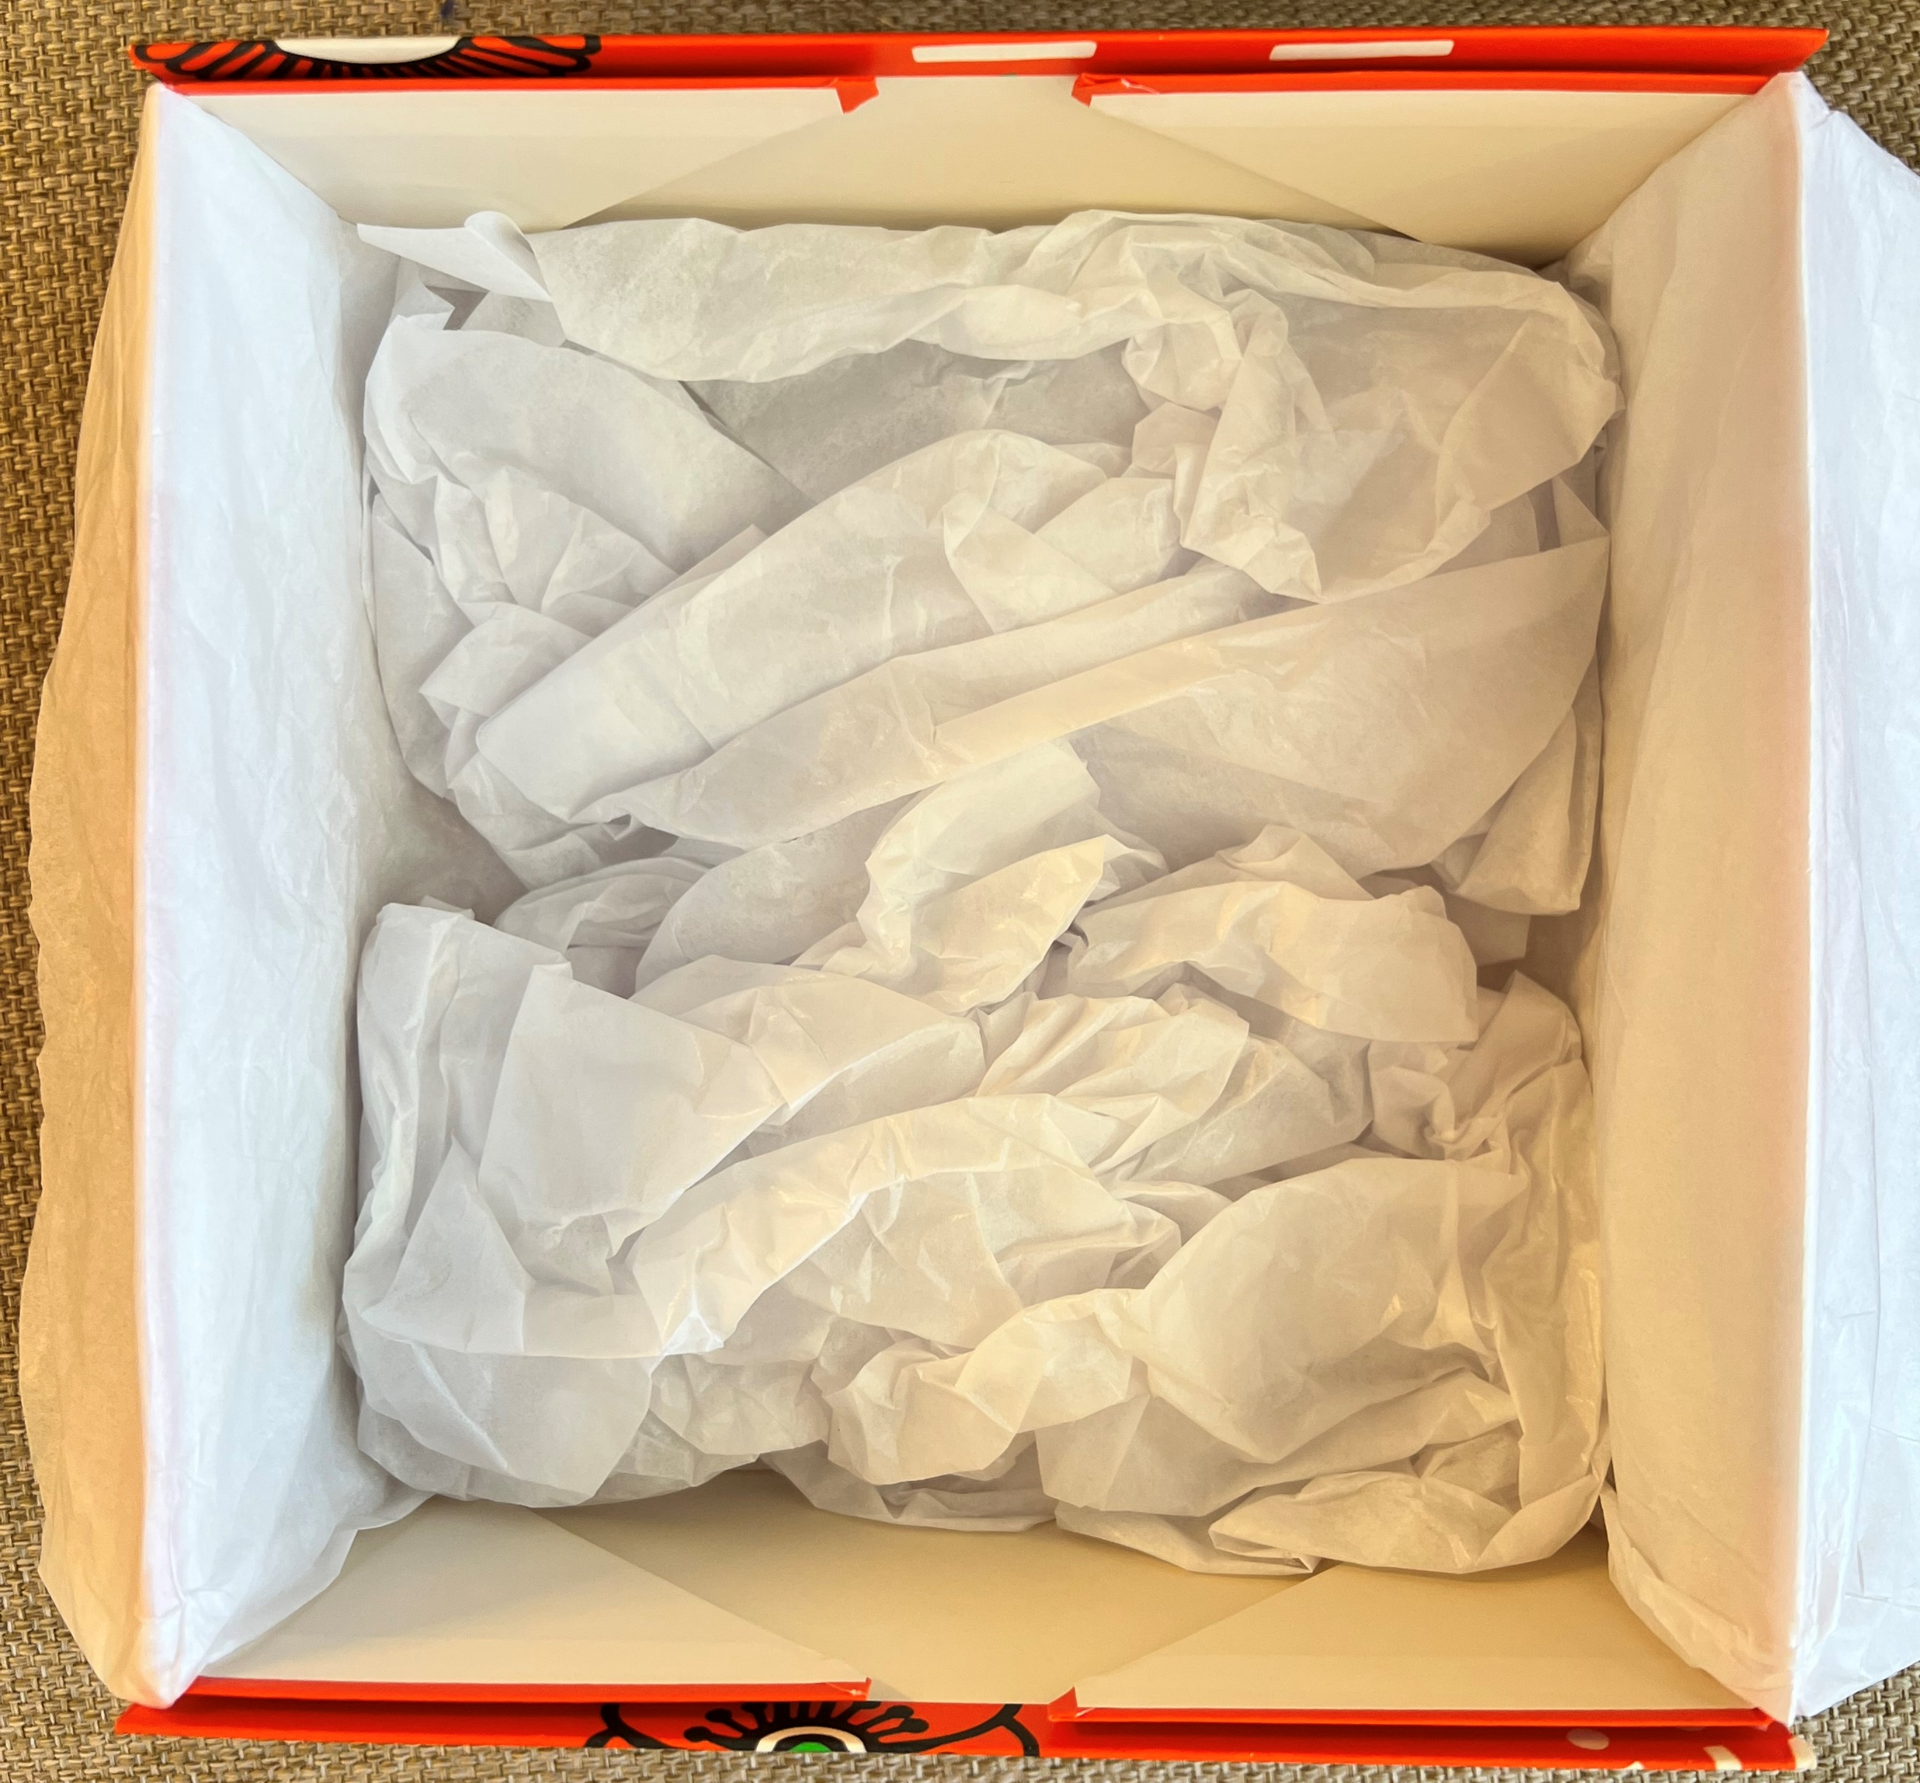
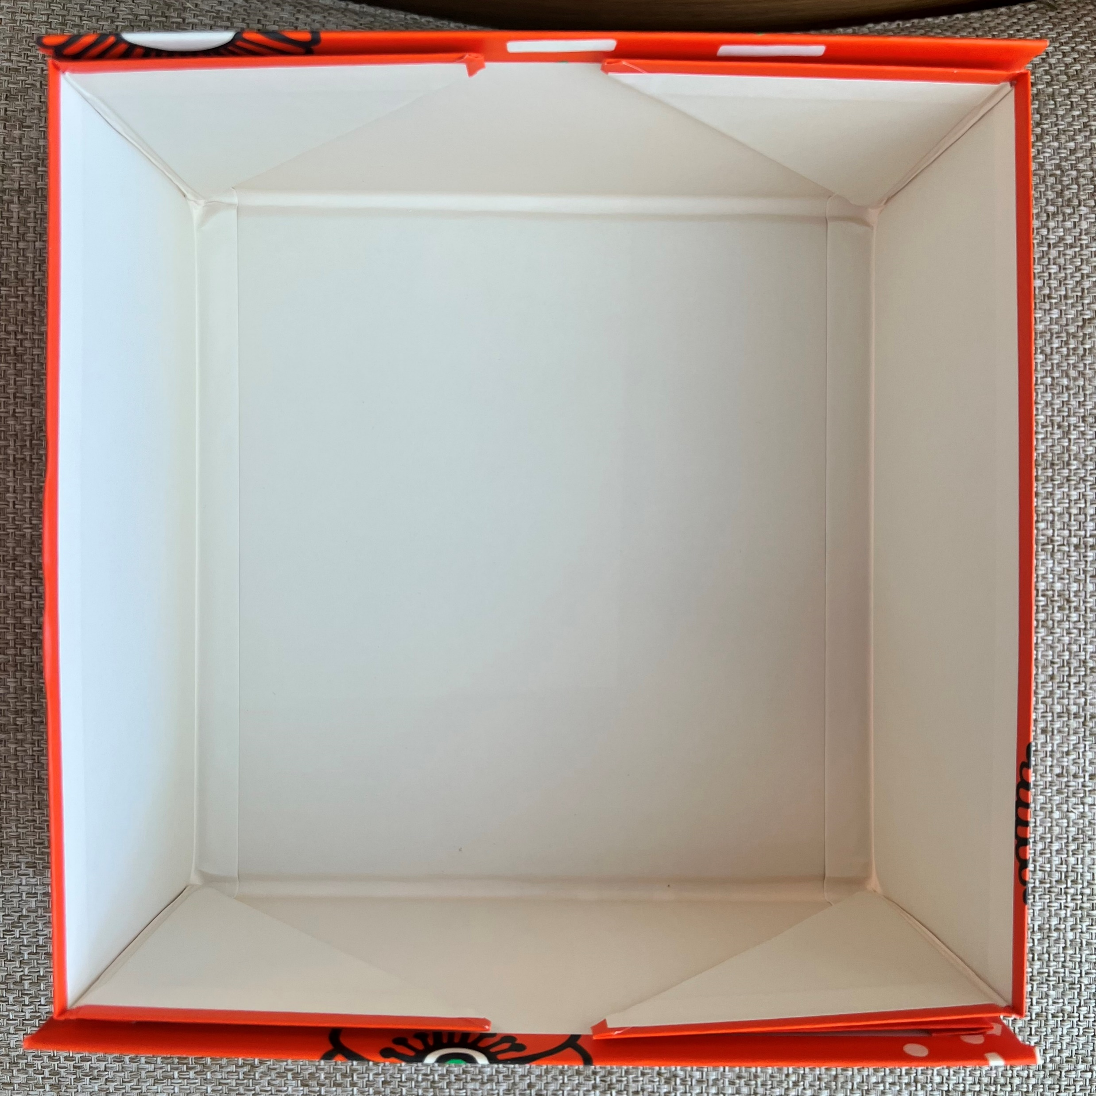
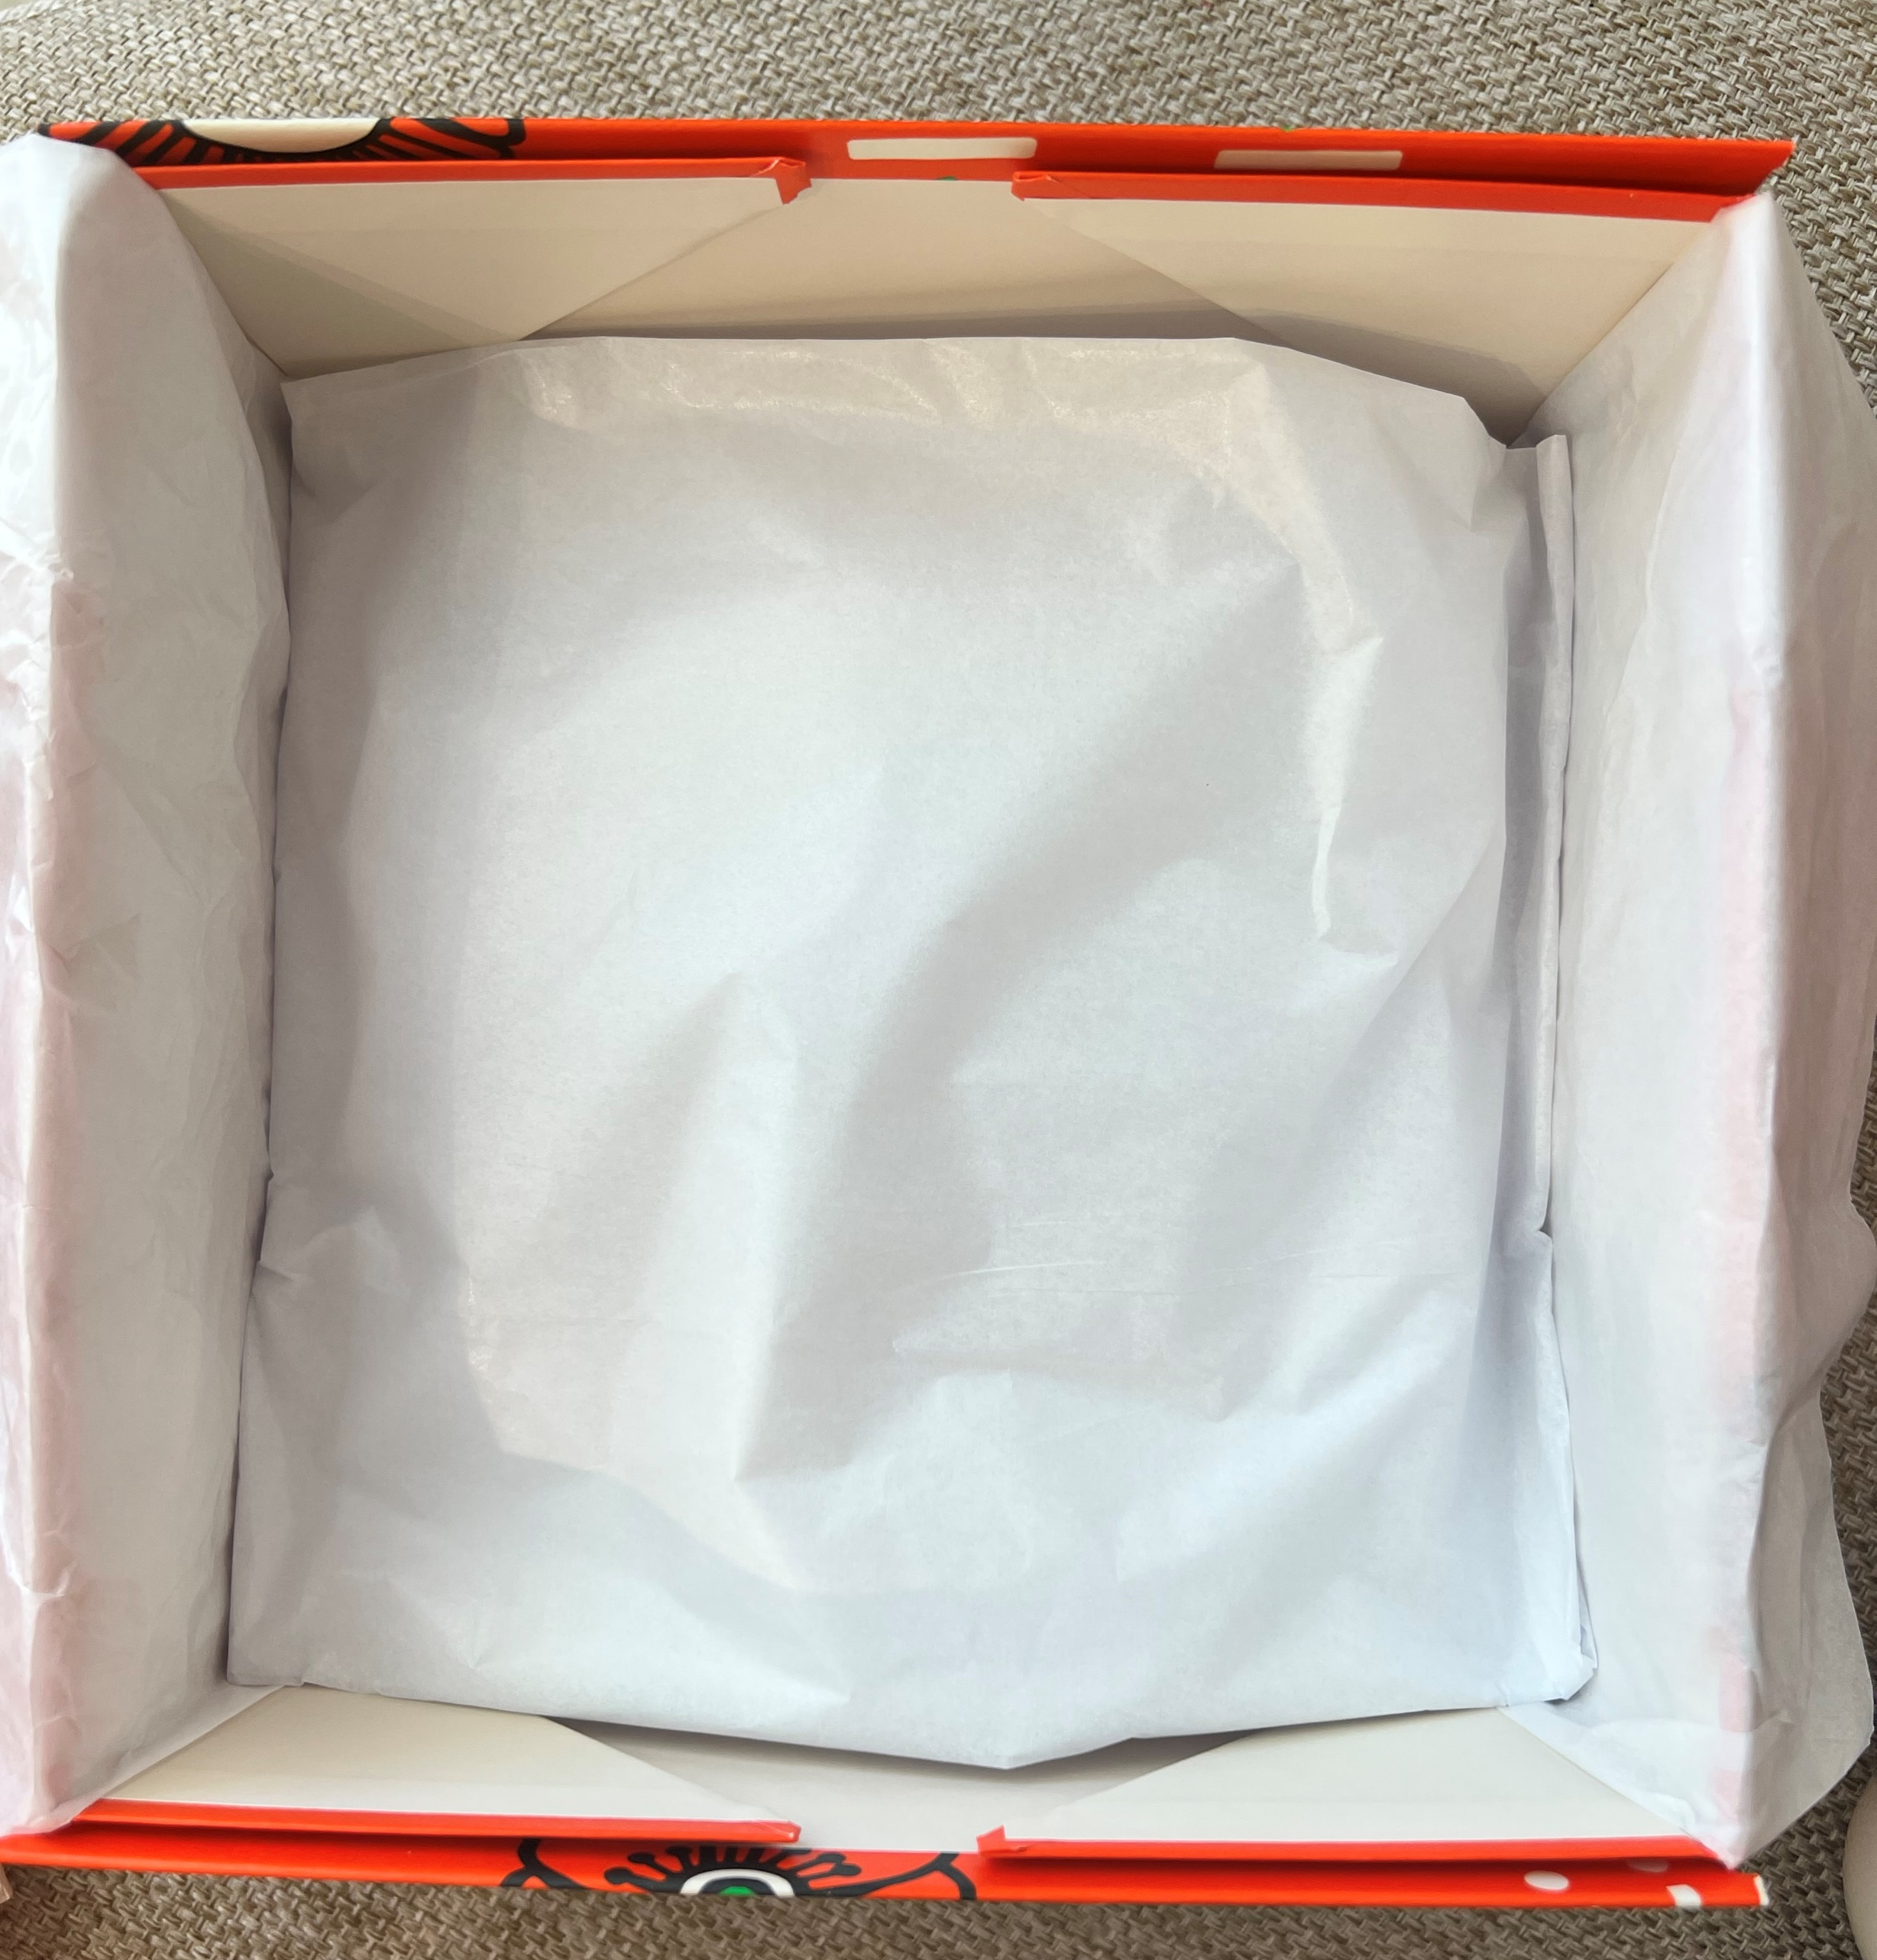
NAOCVKI003311 | 2022_SHEA STAR GIFT_RT
01CP200K22 | SHEA ULTRA RICH BODY CR 200ML
01MA150K22 | SHEA HAND CREAM 150ML
01SA250LT20 | SOAP SHEA MILK 250G
01PI030K18 | SHEA BUTTER FOOT CREAM 30ML
52MMBPNO22F | 2022 HOLIDAY MEDIUM BOX 2F
NAOCVE3001420 | 2022_SHEA STAR GIFT SLV
Box
52MMBPNO22F
Sleeve
NAOCVE3001420
Tissue x 4
Step 1: Build the Box
A. Take the bottom of the box out of the top (52MMBPNO22F - Brown Box); the L’OCCITANE logos should be on the SIDES not the top and bottom when the box is complete.
B. Remove the adhesive tape from both sides of the box and fold the box at the fold lines.
C. Press the sides firmly together.
Step 2: Tissue
A. Fold a piece of tissue in half . (The logo side should be visible to customers when they open the box)
B. Fold the unfinished edge up 1 ¾ inches.
C. Place the tissue paper in your gift box.
D. Crumple two piece of tissue paper and place to fit in the bottom of the box. Place another folded piece of tissue over them to form a “mattress”.
E. Lay the mattress (logo side side facing the customer) in the box.
Step 3:
Place the products in the box in the following order, working clockwise:
Hand Cream 150ml
Shea Milk Soap 250G
Shea Foot Cream 30ml
Shea Ultra Rich Body Cream 200ml
Step 4:
Fold both edges of the tissue paper 1 ½ inches and fold over the products
Place sleeve around box, centering to cover logo
This will be a brown box
A
A
B
A
B
B
C
D
C
E

